Slide 1


Jumpin’
Into Easter
Sugar Cookie Decorating

Slide 2

4
Icings
4
Cookies
Your Cookie Playlist
1
Bunny in a Pot
3
Too Cute Tulip
2
Bunny Face
4
Lucky Bunny’s Foot

Slide 3
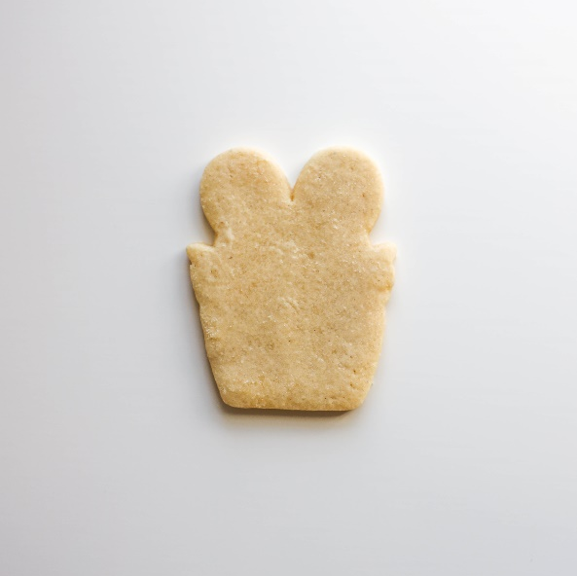
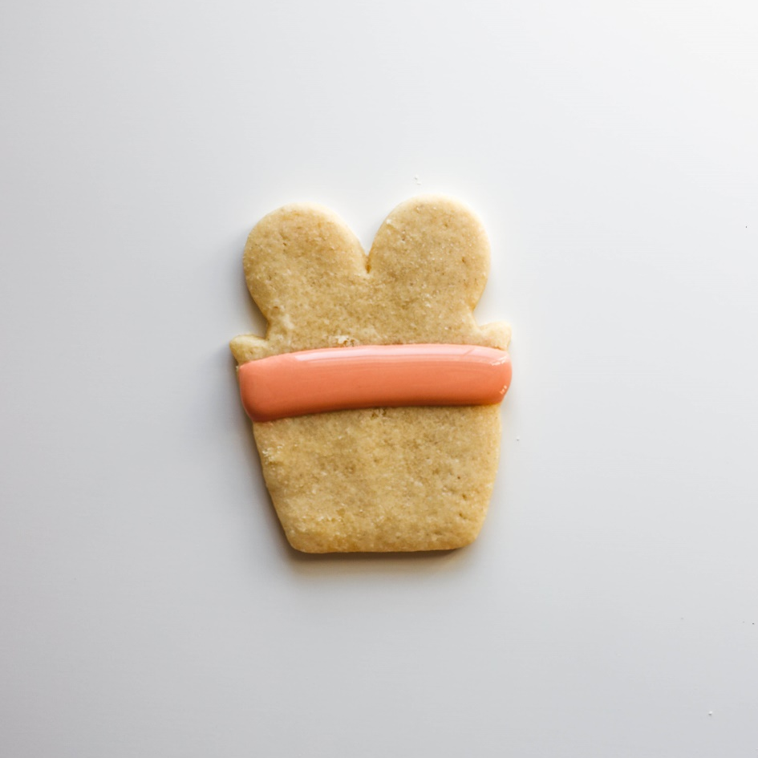
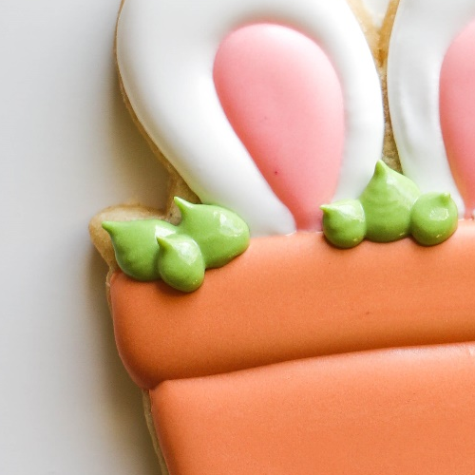
Step 1 – Grab Your Orange Icing and Your
Bunny in a Pot
We’re going to make the clay pot’s brim in orange.
We’re leaving the pot’s base, the grass, and bunny ears blank for now – we’ll come back and do these once the center has crusted!
Leave these parts blank!
Leave space for the
Greenery in a later step >>>

Slide 4
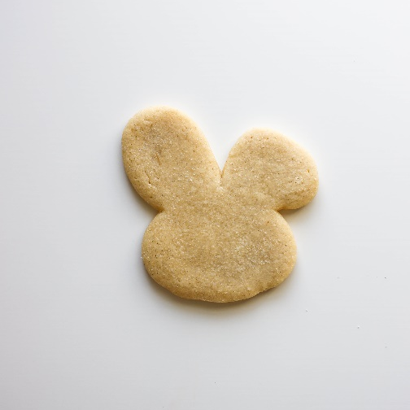
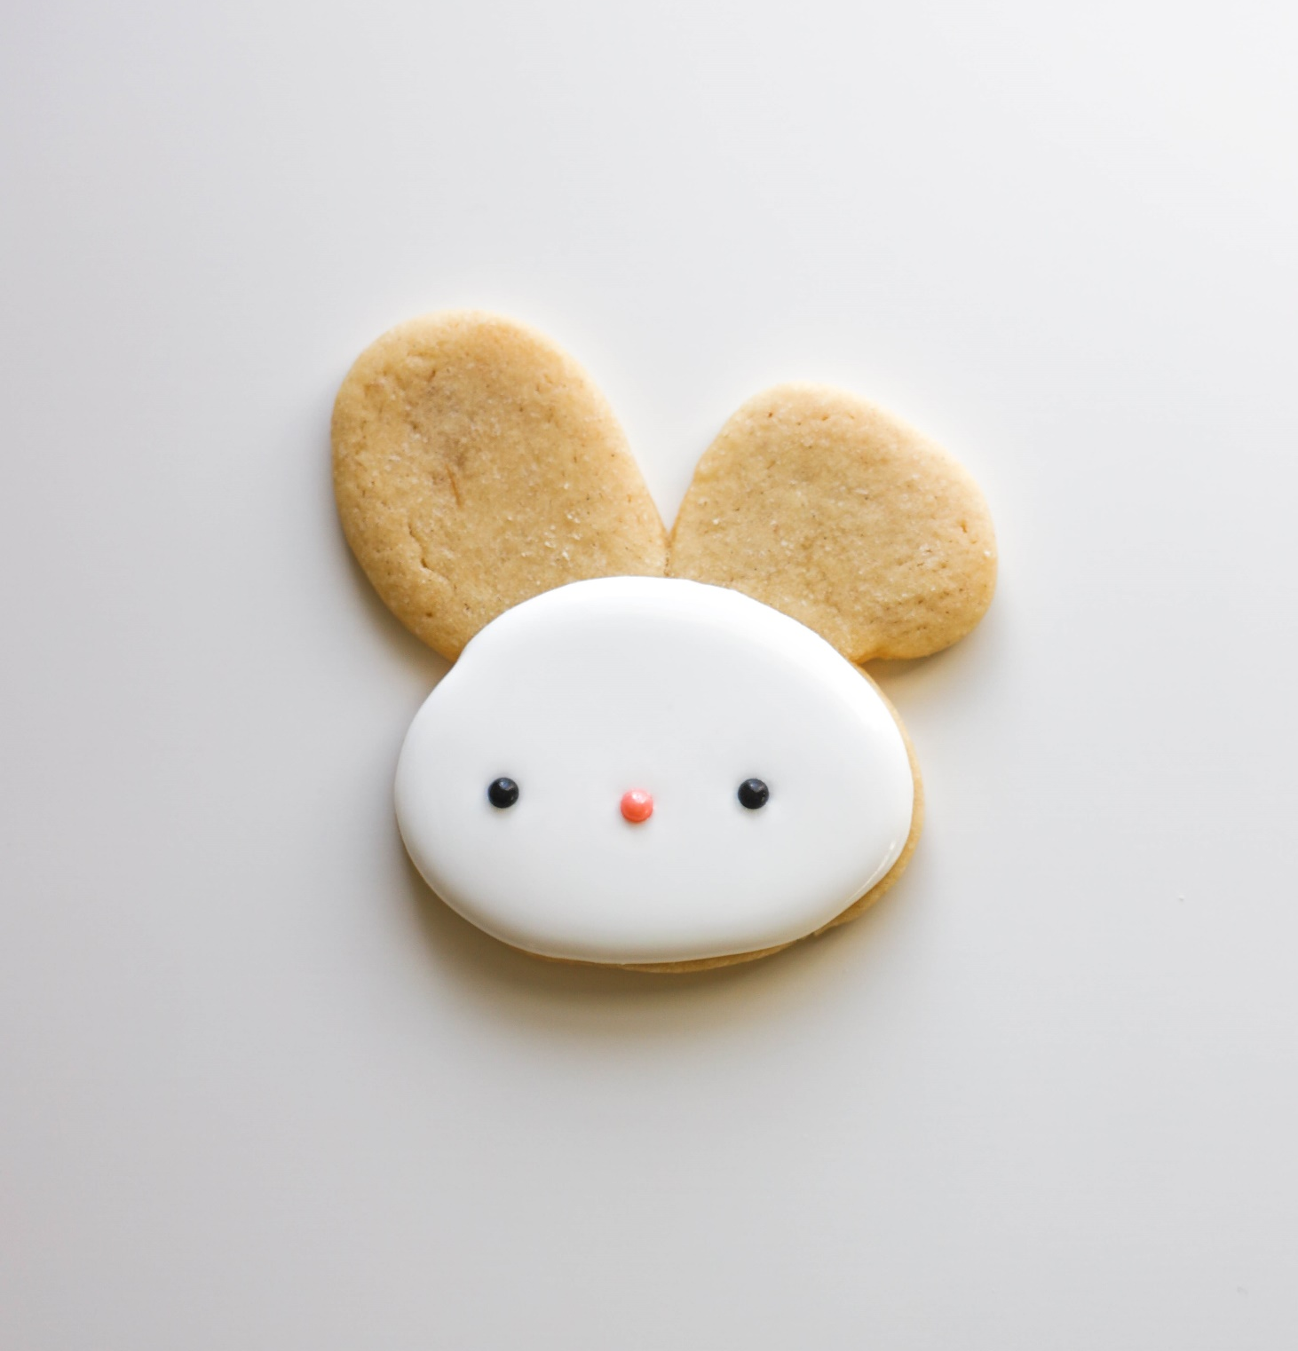
Give me a white circle – but leave off the ears for now! We’ll come back to those later.
Drop in your sprinkles! Drop your eyeballs and button nose – use your scribe or tweezer to move it around.
Have your Sprinkles Ready to Go!
Step 2 – Grab Your White Icing, Black & Pink Sprinkles and Your
Bunny Face

Slide 5
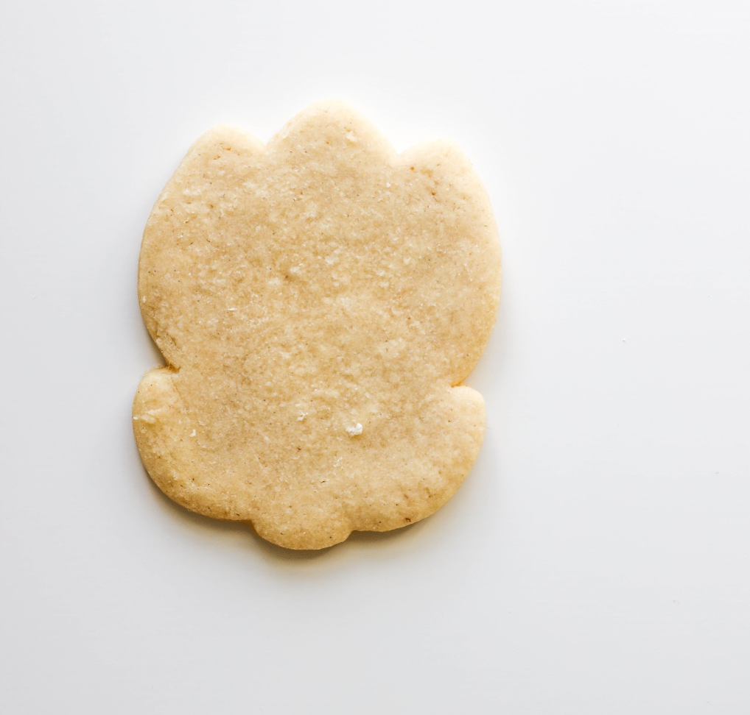
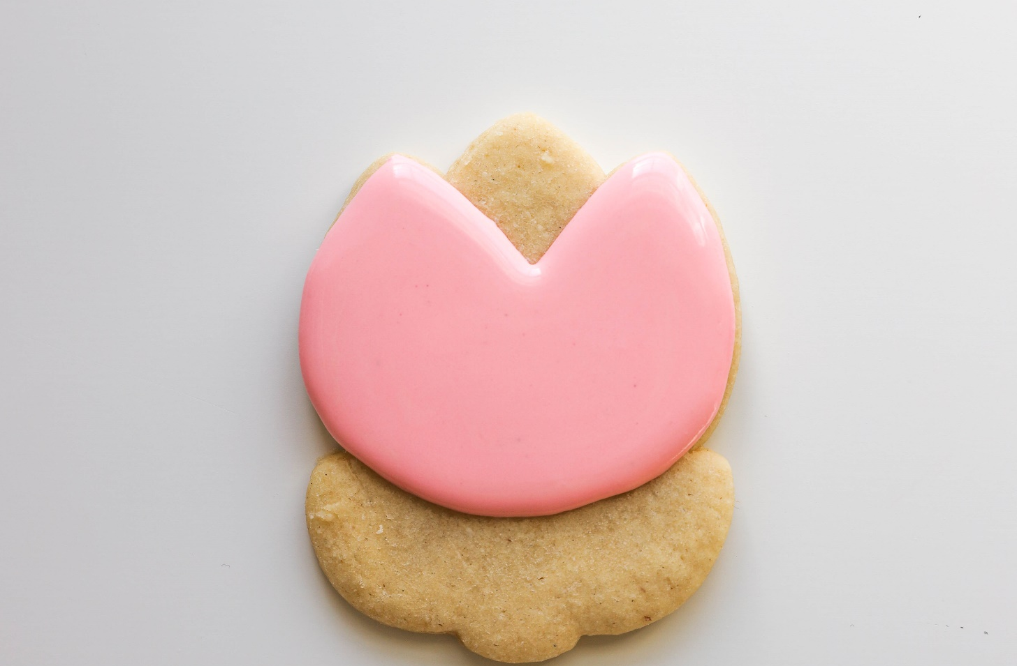
Step 3 – Grab your Pink Icing and Your
Too Cute Tulip
We’re leavin’ out one petal!
Trace, flood, and fix the tulip in pink – but leave the stem and the center petal out for now. We’ll do them later.
Leave a small gap here
Don’t do this part.

Slide 6
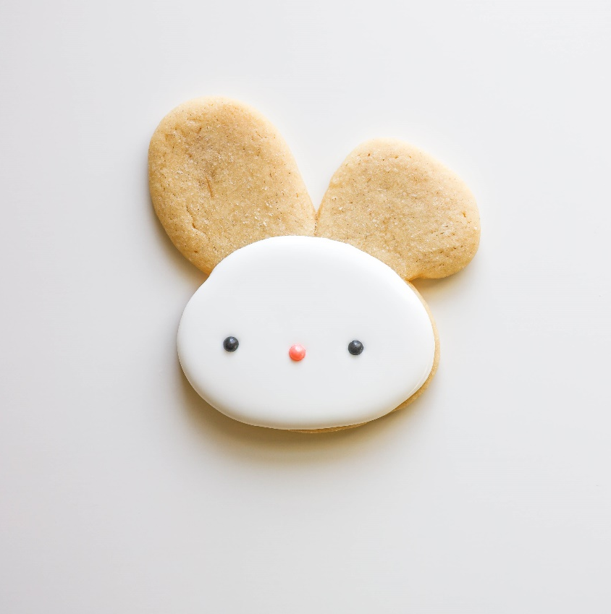
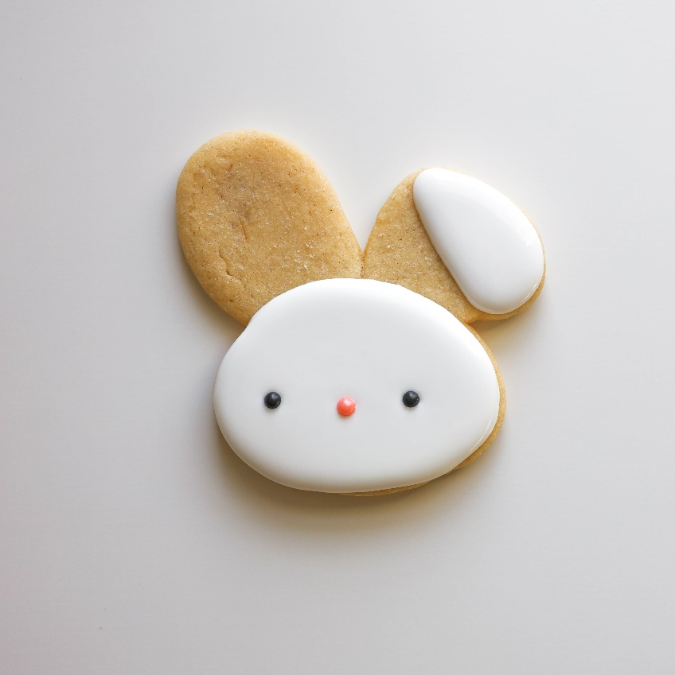
Step 4 – Grab Your White Icing and Your
Bunny Face
Back to the bunny!
We’re going to be doin’ his ears in stages. Right now – give me this oblong circle on his right ear – leave a gap on the cookie. We’ll be makin’ his ear look “folded over.”
>>>>>

Slide 7
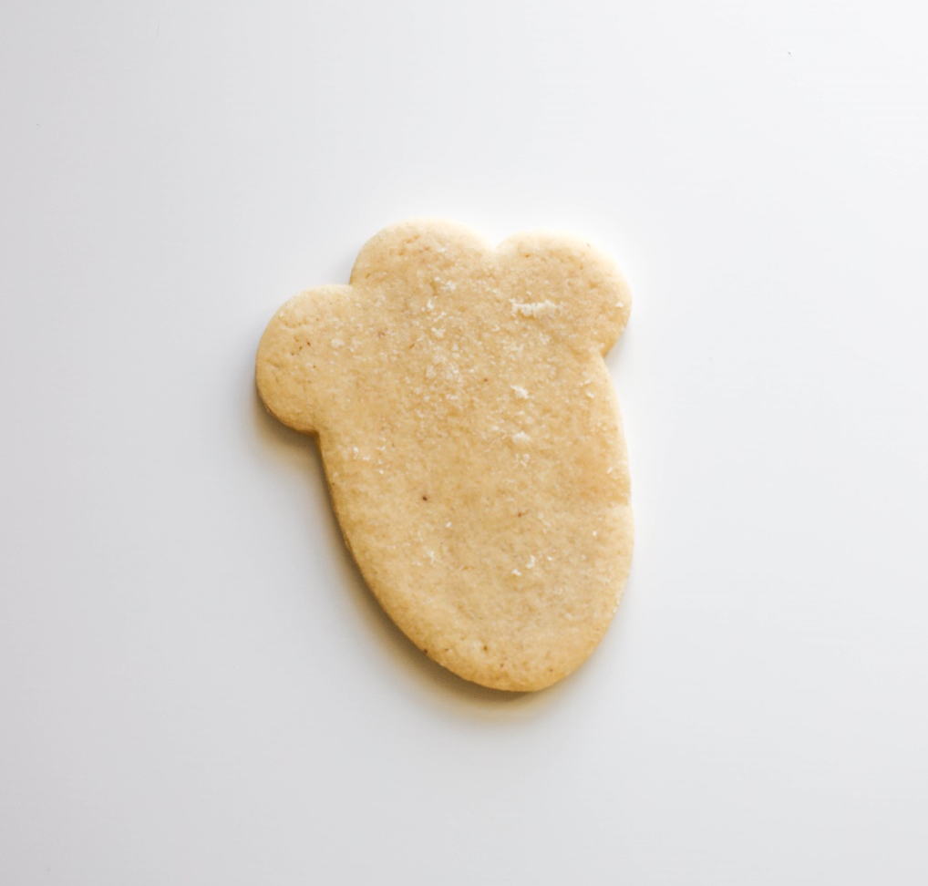
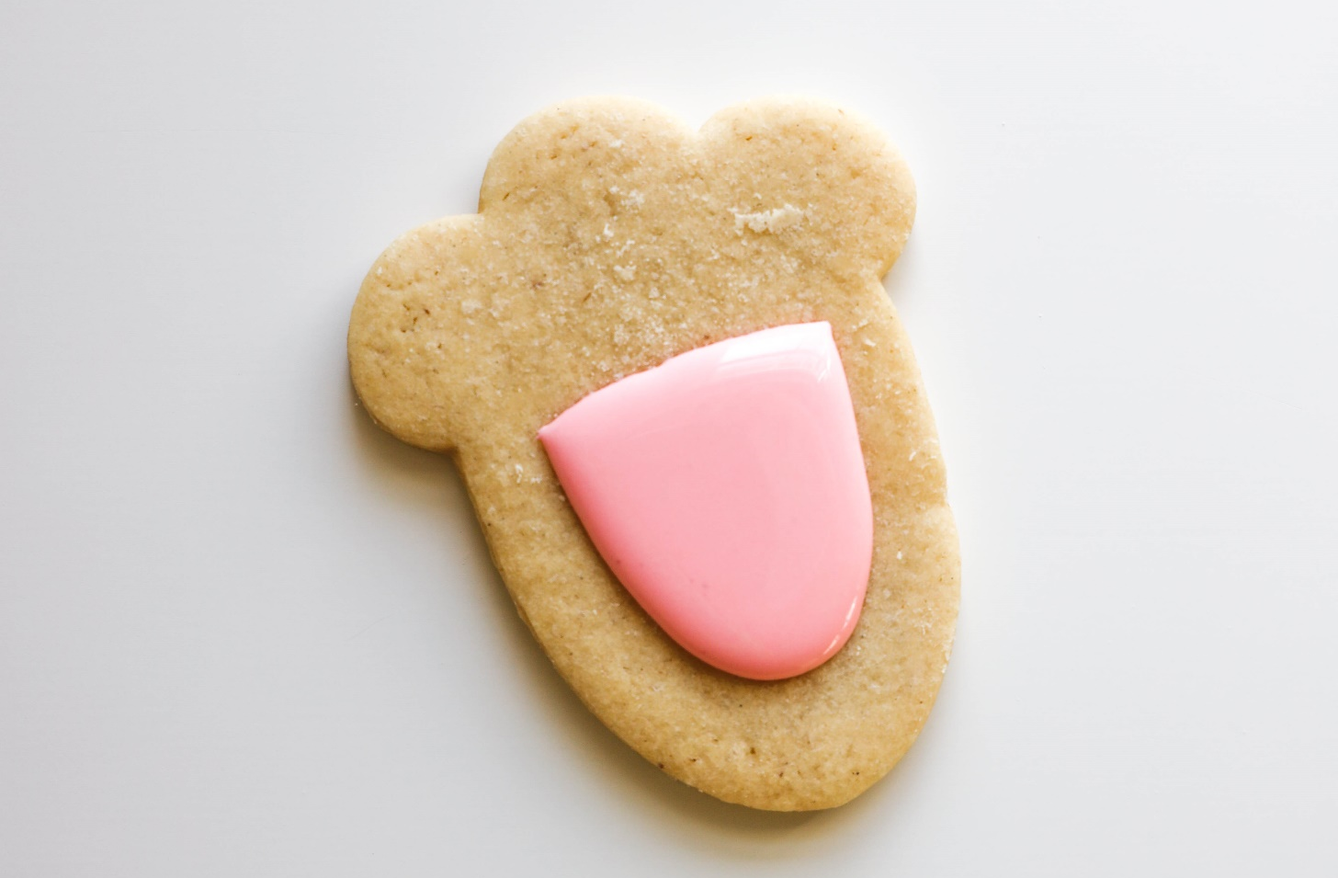
Step 5 – Back to your Pink Icing and your
Lucky Bunny’s Foot
We’re going to make the paw pad. Just the center one – create a U-shape like the one below, then fill it in. Leave everything else blank for now.
Leave a small gap here

Slide 8
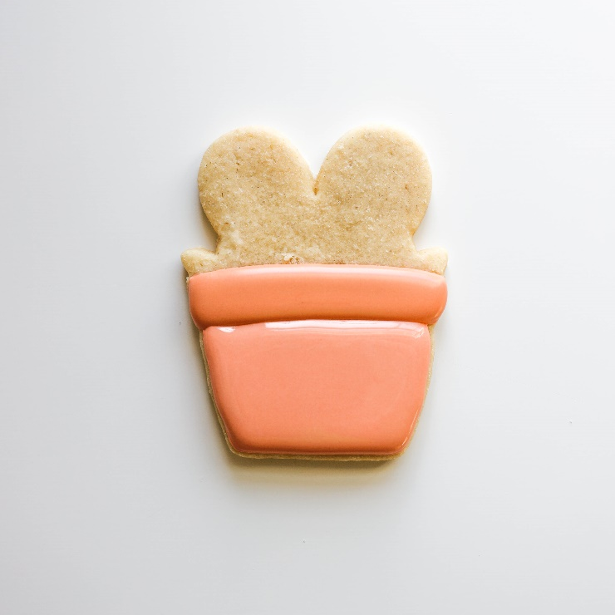
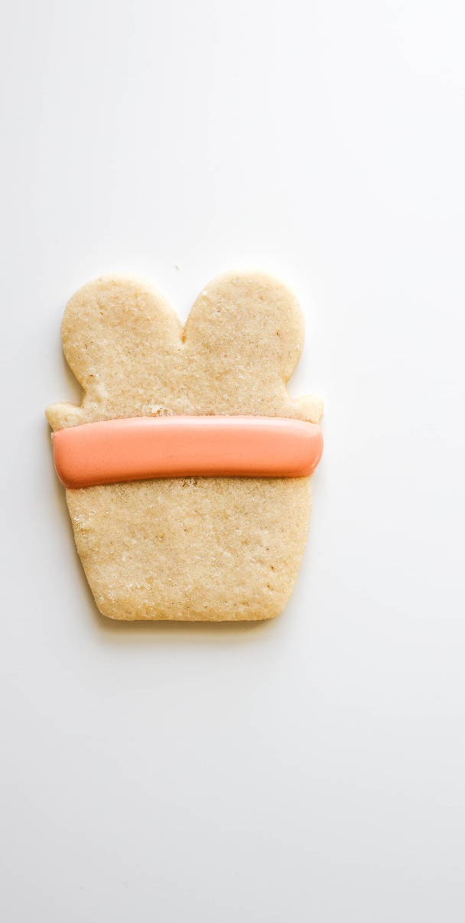
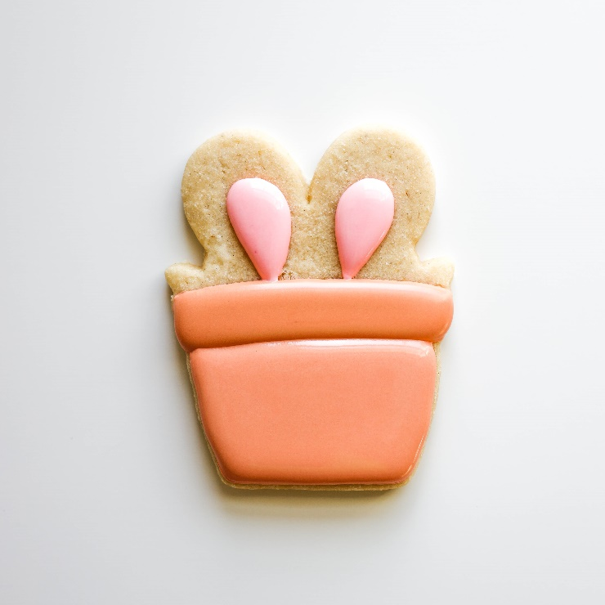
Step 6 – Grab Your Orange and Pink Icing and Your
Bunny in a Pot
1
Let’s flood the pot first – grab your orange icing and flood the lower part of the pot.
>>>>>
>>>>>
Do that part completely. Then continue.
Let’s add the inner ear – give me two pink loops in the center of the ear (leave the outside for white icing later).
2

Slide 9
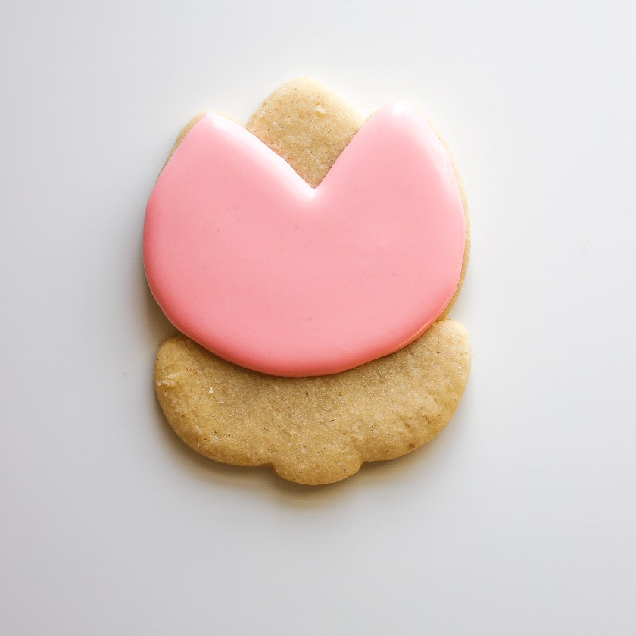
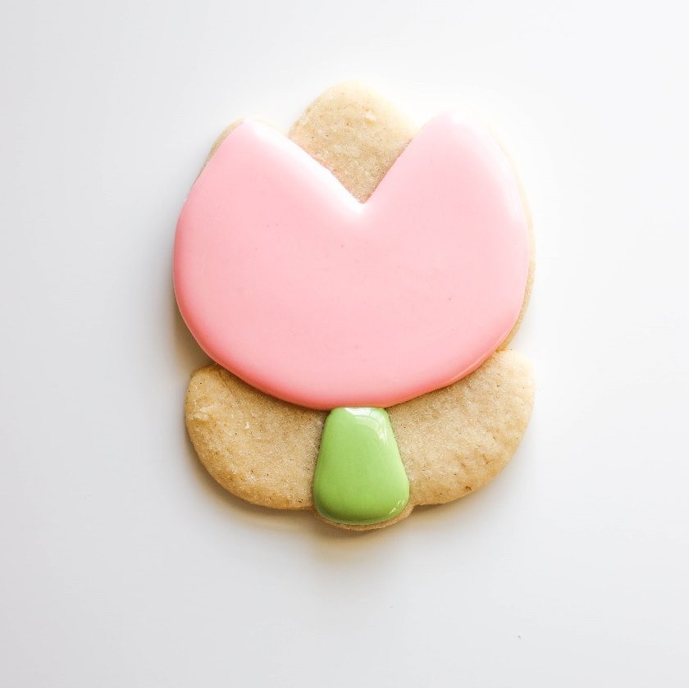
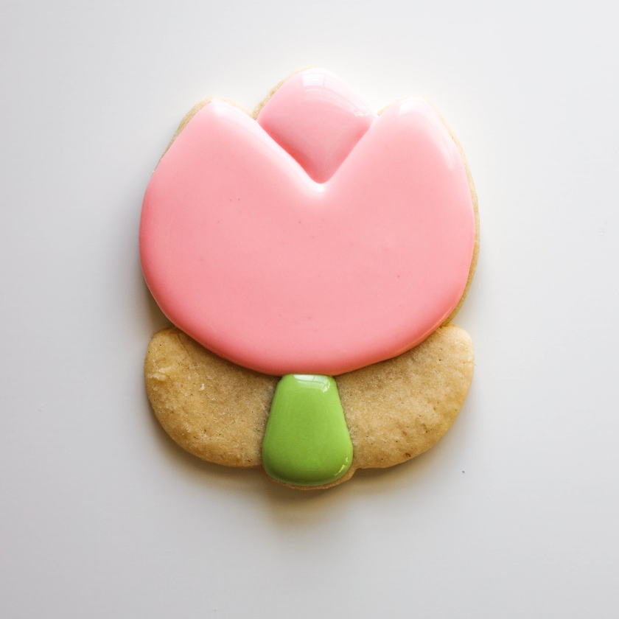
Step 7 – Grab Your Pink and Green Icing and Your
With your green icing, give me a stem (we’ll do the leaves later).
Then with your pink icing, fill in the last petal. When we do these multi-steps, do the first step completely, then go onto the next step.
Too Cute Tulip
This is Another 3-Step Step
>>>>>
>>>>>

Slide 10
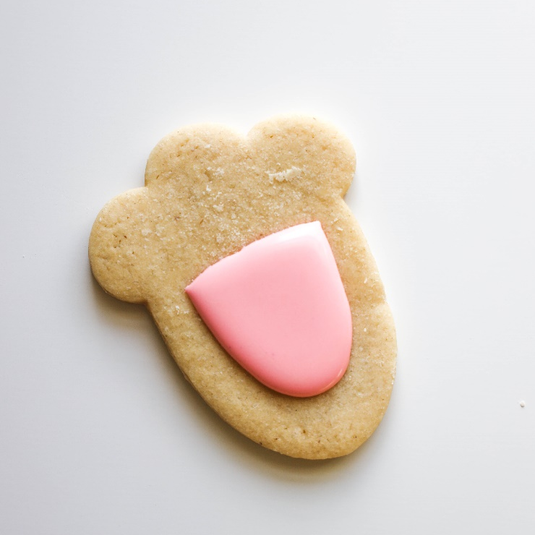

Step 8 – Grab Your White Icing and Your
Lucky Bunny’s Foot
1
Easy step – add the white! Fill in everything left with white – you’ll want to get your white icing to come right up against the pink icing (which has crusted, but definitely isn’t dry) without going on top of the pink.
Use your scribe to move icing closer if needed.
>>>>>

Slide 11
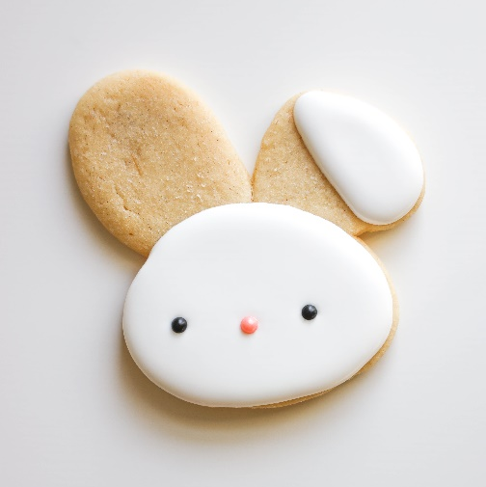

Let’s fill in those ears! Just like in our “bunny in a pot,” fill in just the pink parts of the inner ear.
Use the scribe to push your icing close to the edges!
Step 9 – Grab your Pink Icing and Your
Bunny Face

Slide 12
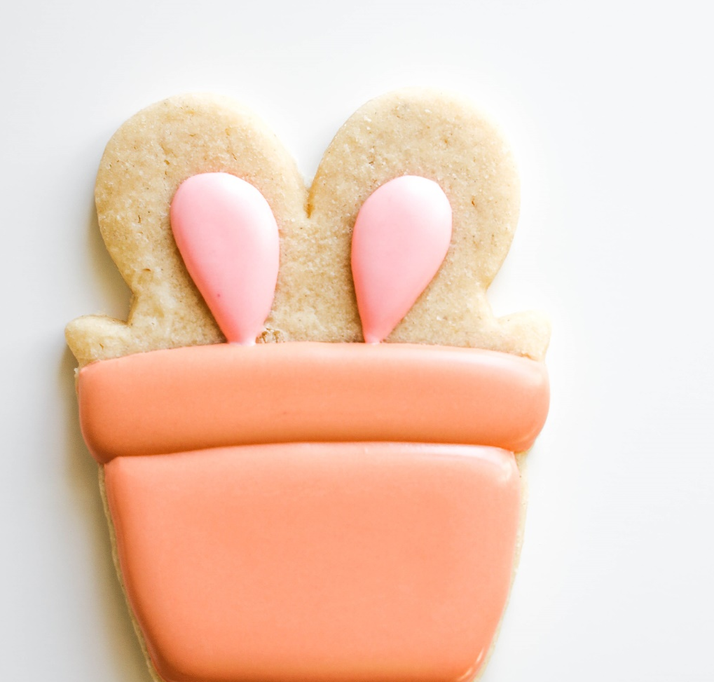
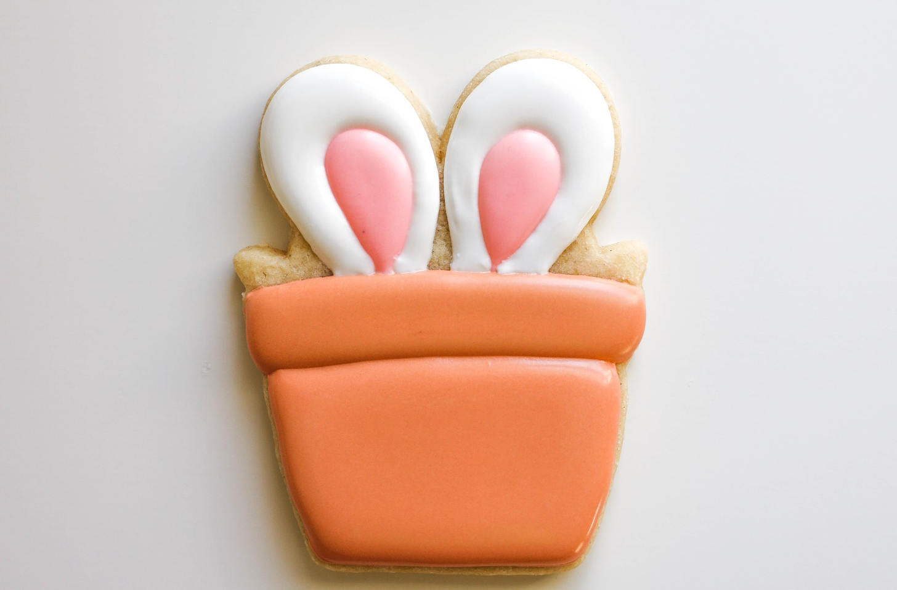
Step 10 – Grab Your White Icing and Your
Bunny in a Pot
Now trace the inner ear with white icing. Leave some blank areas for the greenery but bring your white icing all the way down to the orange clay pot.
Leave space for the
Greenery in a later step >>>

Slide 13


Step 11 – Grab Your White Icing and Your
Fill in any remaining blank parts with white icing – this will wrap up our cute bunny face!
Bunny Face
Ain’t he the CUTEST!

Slide 14

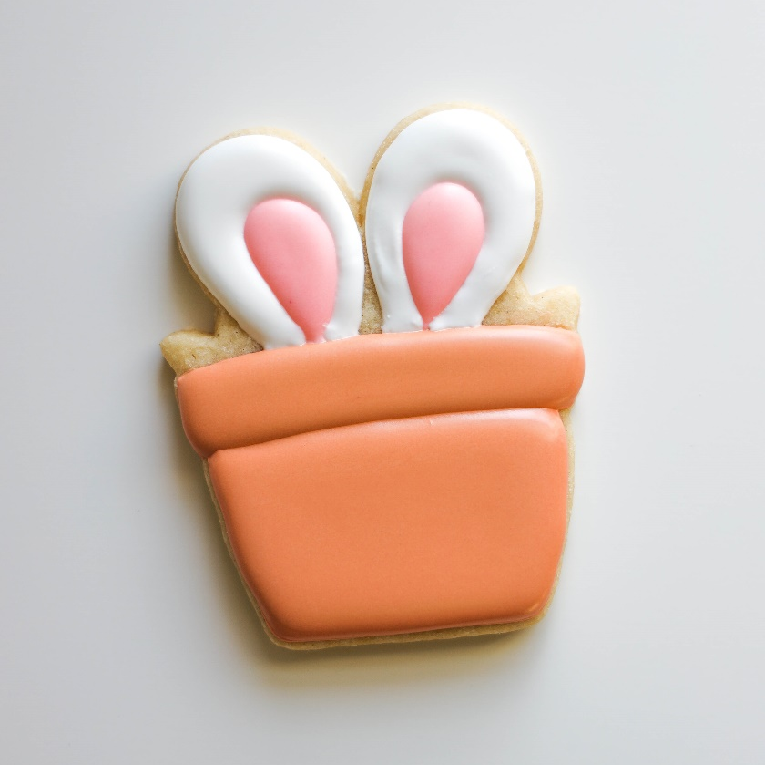
Step 12 – Grab Your Green Icing and Your
Add some green leaves with your green icing – I did groupings of three leaves – but choose what you like best! I’d suggest doing one leave on the left, one leaf in the middle, one leaf on the right – then repeat.
Bunny in a Pot
Add green leaves
>>>>>

Slide 15
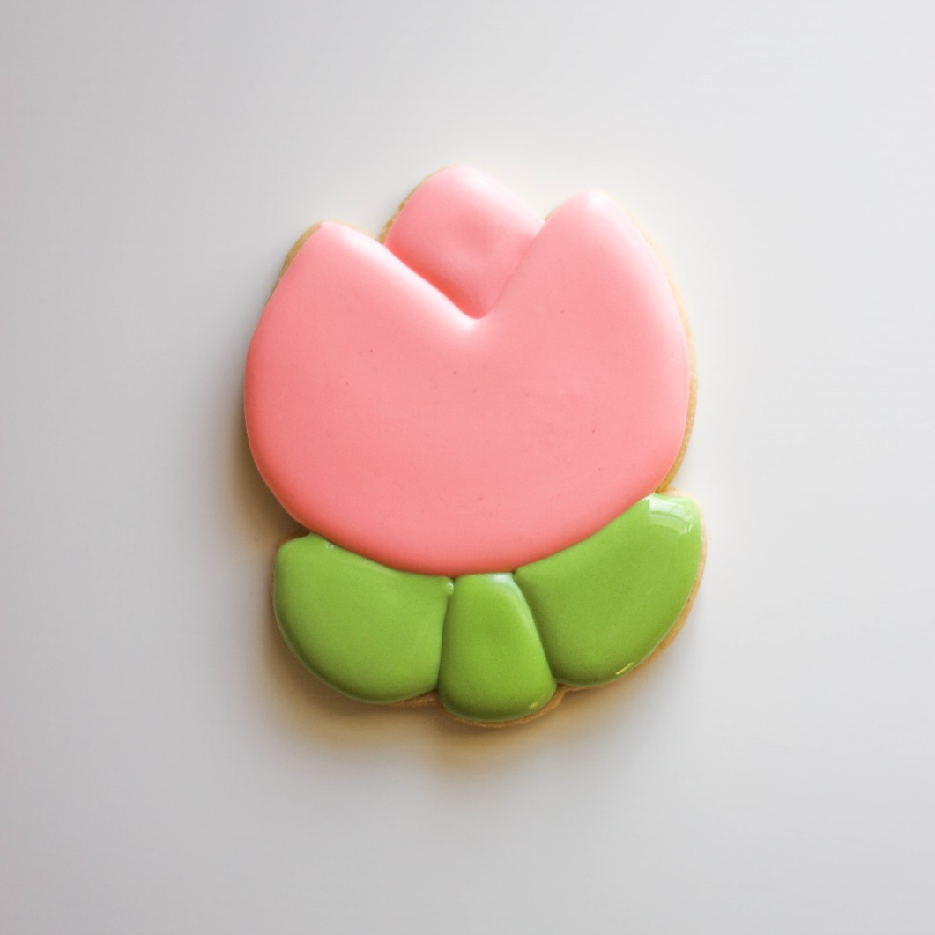
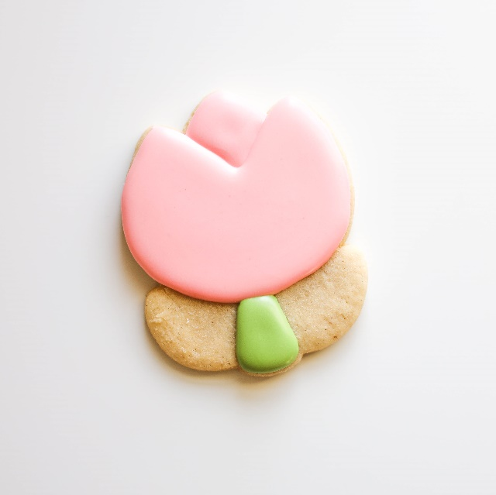
1 >
Step 13 – Grab your Green Icing and Your
Too Cute Tulip
This almost wraps up our Flower!
Give me the two leaves in your green icing – that’s it! We’re almost done with our too cute tulip! What do ya think!? Next up for it – line work!

Slide 16


Step 14 – Grab your Pink Icing and Your
Lucky Bunny’s Foot
We’re going to make heart-shaped toe beans. To make a heart, you combine two upside-down “rain drops.”
1
2
The toe beans
End at the bottom point

Slide 17
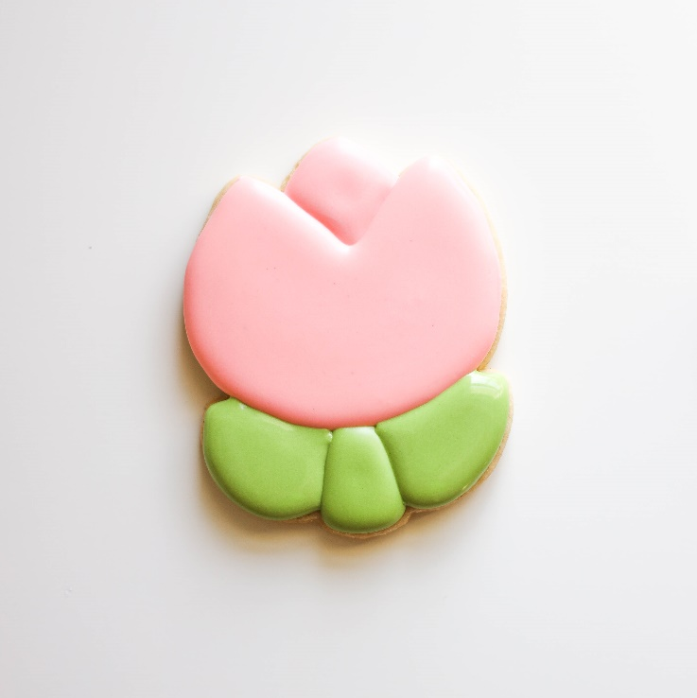
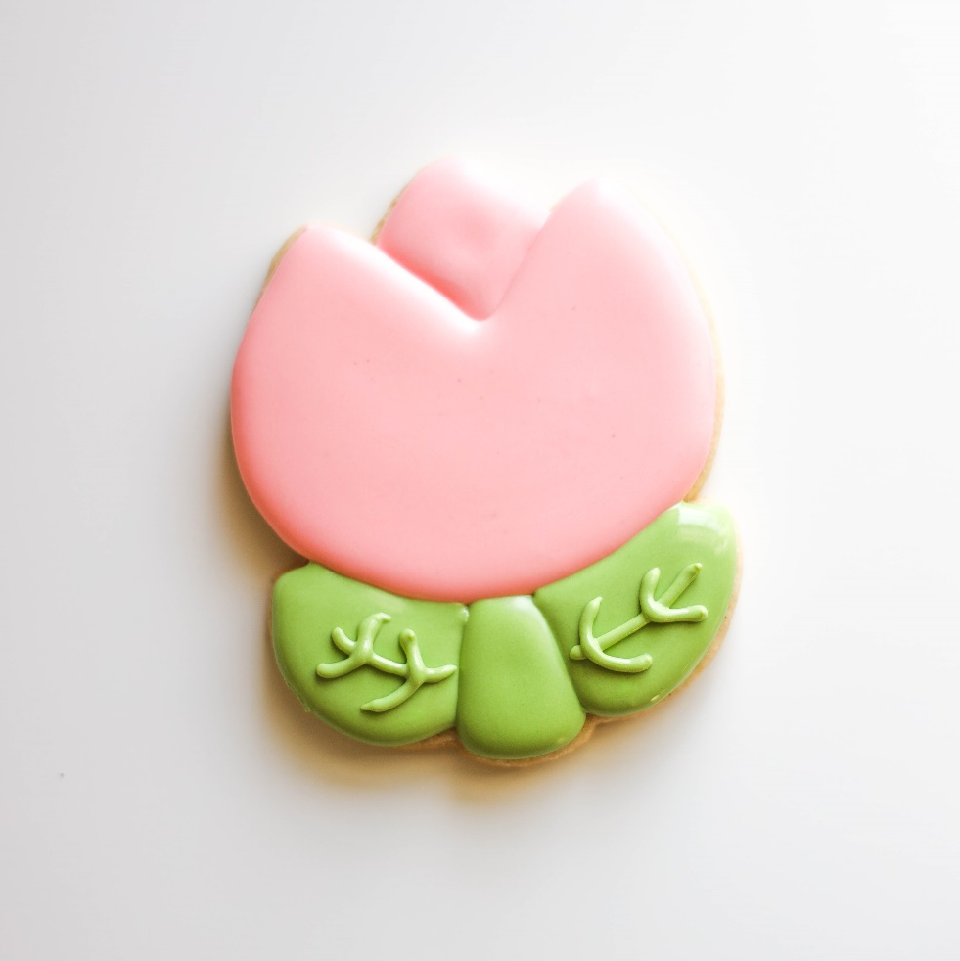
Step 15 – Grab Your Green Icing and Your
Too Cute Tulip
Careful – that icing isn’t dry yet!
1
Add the leaf veining - grab your green icing and give me some veins. NOTE – your green icing below is not dried yet – so be gentle! We don’t want to crack our icing.
This is called Line Work!

Slide 18
Cookie
Class
Kits
You’re
Done!

